Slide 1

Assessing technical debt for Protiviti
By:
Abhinav Tandon
Akshaya Sivakumar Karunambika
Aneri Shah
Courtney Monaghan
Dhruv Dhami
Manthiramoothy Cherathian

Slide 2
Table of Contents
Topics
Page Number
Client information
3
Project goals
4
Approach
5
Technical debt and reasons
6
Types of technical debt
8
Impact of technical debt
12
Our proposed approach for technical debt assessment
17
Mitigation proposals
27
Conclusions
28
References
29

Slide 3


Protiviti provides consulting solutions in finance, technology, operations, data, analytics, governance, risk and internal audit to our clients through our network of more than 75 offices in over 27 countries
Serve 60% of Fortune 1000®
Serve 35% of Fortune Global 500®
Protiviti is a subsidiary of Robert Half International.
Protiviti works with small, mid, large-sized companies as well as with government agencies.
Notes:
Information Source - https://www.protiviti.com/US-en/about-us

Slide 4


Project goals
Investigate the types of technical debt and the impact on the organization
Build a framework to quantify and prioritize the domains that have greater technical debt

Slide 5
Approach
Researched about technical debt and the impacts on projects and portfolios
Discussed with 15 project managers about their experiences with technical debt in the following business areas:
HR: Recruiting & Payroll
Data Warehousing & Analytics
Purchasing
Application Security

Slide 6

What is technical debt?

Slide 7

Technical debt
Definition: The consequence of choosing a quick solution, implying re-work to be done
Reasons
1. Accidental
Occurs when a process is not followed
2. Inevitable
Occurs when scope changes, new requests or tool upgrades take place causing a change in the original design
3. Strategic
Intentionally accruing technical debt because of constraints (cost, time, resources, organizational decisions etc.)
Notes:
Image source: https://agilepainrelief.com/blog/paying-down-technical-debt.html

Slide 8
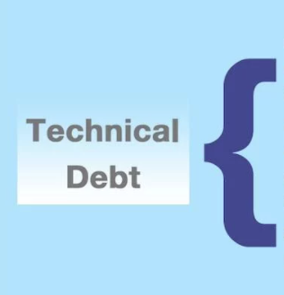
Types of technical debt
Bit Rot/Software Entropy​​
Legacy System (Code)​​
Shadow IT
Scope Creep​​
Employee Churn
Lack of Skillset
Lack of Cross Trained Resources
In-House Productivity
Outsourcing
Documentation Debt​
Task Estimation
Notes:
Image source: https://itchronicles.com/business-agility/a-look-at-technical-debt/

Slide 9



Types of technical debt
Bit rot
Legacy system
Shadow IT
Software Entropy is the tendency for an instance of software to become increasingly error prone with time
Causes:
1.Software age
2.Obsolete documentation
Legacy system is an old method, technology, computer system, or application program, "of, relating to, or being a previous or outdated computer system," yet still in use.
Causes:
1.Application dependency on outdated technologies, libraries or frameworks
2.Insubstantial or non-existent documentation
Current resources do not have the right level of competence in a module or skillset
Causes:
1.Use of unauthorized and unauthenticated hardware and software resources that are not defined in the organization's architecture

Slide 10




Types of technical debt
Scope creep
Employee churn
Lack of skillset
Lack of cross training
Project's scope, deliverables, or features expansion from what was originally set, without additional time or budget being accounted for
Causes:
1.Lack of clear requirements
2.Gold Plating, developers add extra features without client knowledge
Employee churn is the offboarding or resources within a team or organization
Causes:
1.Lack of learning opportunities
2.Lack of innovative topics
Current resources do not have the right level of competence in a module or skillset
Causes:
1.Lack of team diversity
2.Organizational factors – resource utilization over skill
Lack of cross trained resources is when there are SMEs, and the current resources are not able to have a proxy/substitute team member make decisions or provide feedback in their absence
Causes:
1.Lack of knowledge transfers
2.Lack of documentation/process definition

Slide 11




Types of technical debt
In-House productivity
Outsourcing
Documentation debt
Task estimation
Development is taken care of by in-house software developers
Causes:
1.Strategic implementation
2.Lack of cross trained resources
3.Lack of project scalability
Delegating tasks, projects and/or processes to external entities or third-party vendors
Causes:
1.Cost reduction
2.Flexibility of project development within deadlines
Any process or code that is built or maintained without any supported documentation
Causes:
1.No formal policy for Documenting Code/ Processes
2.When developers fail to document the code or a new process, requirements or design changes
Estimating tasks is a process in SDLC to predict the realistic effort and time required in developing the product
Causes:
1.Development time calculated by non-programmers
2.Lack of continuous task assessment

Slide 12
Impact of technical debt
Productivity pressure
Low productivity
Higher technical debt
Lower morale and output quality
Notes:
Image reference : https://devopedia.org/images/article/211/1799.1594111209.png

Slide 13
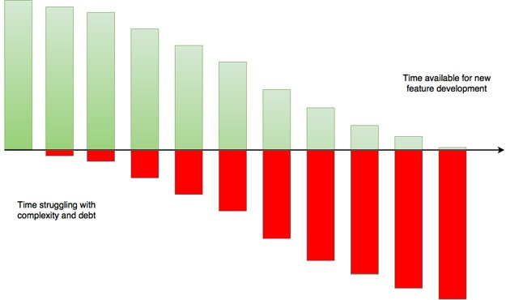
Impact of technical debt on projects
Increase of defects/bugs
Less time spent on project deliverables
Lack of motivation
Increased project budget
Increased customer complaints
Notes:
Image source: https://medium.com/serious-scrum/the-hidden-cost-of-technical-debt-1963b958e5ed

Slide 14
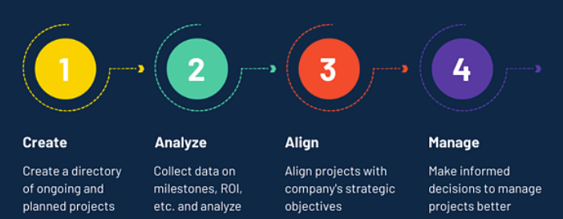
Portfolio management
Portfolio is a collection of projects
Portfolio management is a way to bridge the gap between strategy & implementation
The goal is to balance strategic initiatives and resources to optimize the return on investment(ROI)
Notes:
Image source: https://learn.g2.com/it-portfolio-management

Slide 15
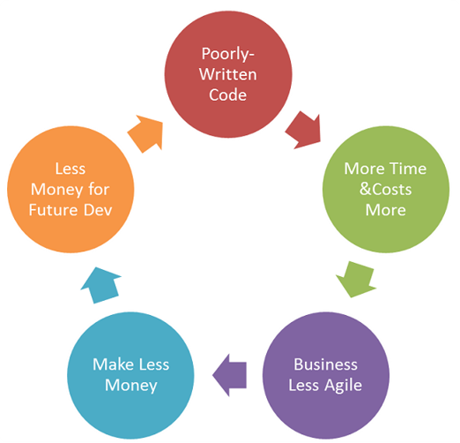
Impact of technical debt on portfolio
Reduced agility and market competitiveness
Affects returns on projects due to
Risk of revenue loss
Monetary penalties incurred for missing project milestones
Non-compliance during security audits could result in huge fines
Longer time period to recover project investment
Resource allocation
Notes:
Image source : https://www.red-gate.com/blog/database-devops/devops-automating-repayment-technical-debt-devopsguys

Slide 16
Impact of technical debt on portfolio
Strategy
According to a study by Claranet:
84% of organizations cite technical debt as a significant issue limiting their ability to respond quickly to customer demand with new software feature release
25% of the budget is spent on technical debt for large software enterprises
Portfolio Management
Do the "right" projects
Program Management
Do the projects
right
Project Management
Notes:
Image reference: https://coreconsulting.com.au/governing-projects-programs-portfolios/
Other sources: https://www.information-age.com/technical-debt-a-123484731/

Slide 17
Our proposed approach for technical debt assessment

Slide 18
Our proposed approach for technical debt assessment
Segmentation of framework into domains
Identification of associated technical debt(s)
Creation of questionnaire
Definition of scoring rubric
Creation of ReadMe guide
Assessment of scores & proposed mitigation plans

Slide 19






Framework domains - explained
Application
Program(s) developed for an end user
Infrastructure
Hardware/software components, servers, data centers
Partnering
Onsite, offshore & near shore agreements
People
Technical & functional team members and stakeholders
Process
Defined framework(s) for optimal IT development
Security
Security protocols, patching and measures implemented for the project

Slide 20

How to fill out the assessment questionnaire?

Slide 21
Questionnaire
An excel spreadsheet to quantify:
What type of technical debt exists
Which domain has the highest technical debt
A Readme tab with instructions and glossary to help fill the questionnaire
A Summary tab that shows:
Technical debt score & percentage for each domain
Overall tech debt score & percentage
Interpretation of the scores generated

Slide 22
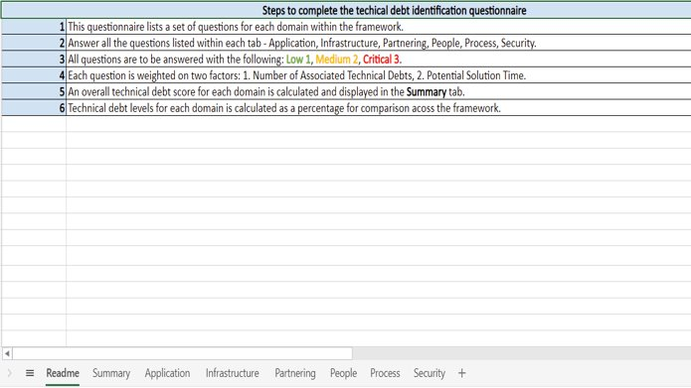
Each tab consists of a set of questions mapped to a technical debt type

Slide 23
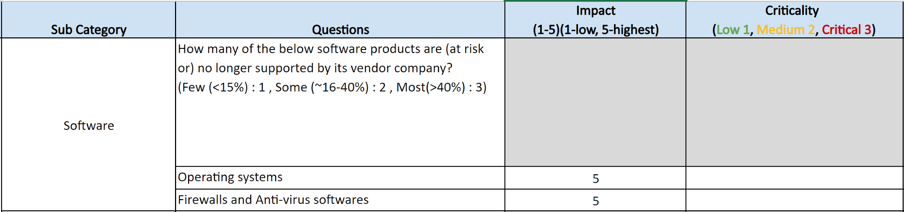
Questionnaire
Each question has a predefined impact score that is based on two factors:
Number of associated technical debts
Potential solution time
All questions are to be answered with the following:
Low – 1 , Medium – 2 , Critical – 3
An overall technical debt score is generated
Access the Technical Debt Assessment Framework Here!

Slide 24
A summary tab outlines the scores for each technical debt domain

Slide 25
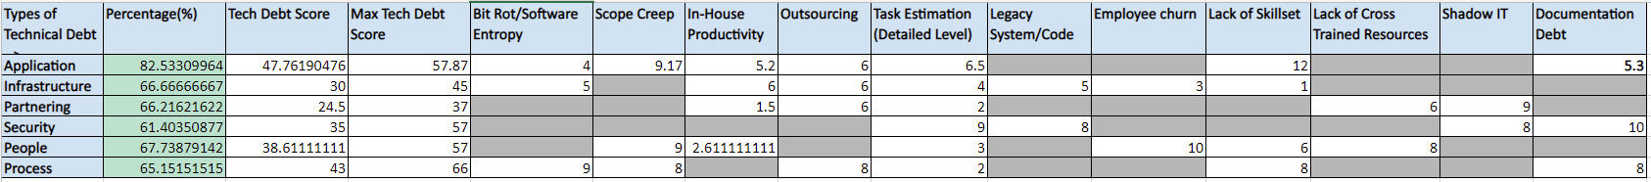
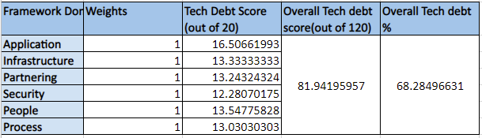
Summary
Technical debt score for each domain – split across each debt type
Technical debt percentage for each domain to identify the domain with the highest tech debt.
Overall tech debt score and percentage to assess the total tech debt.

Slide 26
Interpretation of technical debt scores
Score | Impact | Mitigation proposal
<30% | Acceptable | N/A
31% - 50% | Low | Monitor progress
51% - 70% | Moderate | Requires attention
>71% | Critical | Requires immediate action

Slide 27
Technical
debt
mitigation proposals
Technical Debt | 2 Mitigation Proposals
Bit Rot/Software Entropy | Code refactoring | Testing in regular intervals
Scope Creep | Requirements verification with stakeholders. | Clear project schedule
In-House Productivity | Performing cost-benefit analysis. | Deploy financial models/ set threshold limits.
Outsourcing | Technical debt sync between partners and organization. | Due diligence to ensure alignment of business outcomes.
Task Estimation | Estimation to involve both technical and functional teams | Implement continuous assessment
Legacy System/Code | Re-architect the system | Re-platform the system
Employee churn | Training/upskilling | Onboard/offboard Process
Lack of Skillset | Training | Team agility
Lack of Cross Trained Resources | Paired working | Regular knowledge transfers
Shadow IT | Policies for use of these resources | Educating the employees
Documentation Debt | Formal documentation process | Training employees

Slide 28
Conclusion
Overall view of technical debt in different domains ​
Helps drill-down on the various causes of it​
Technical debt is difficult to manage​
Technical debt is inevitable! ​

Slide 29
References
https://coreconsulting.com.au/governing-projects-programs-portfolios/
https://www.information-age.com/technical-debt-a-123484731/
https://medium.com/serious-scrum/the-hidden-cost-of-technical-debt-1963b958e5ed
https://www.red-gate.com/blog/database-devops/devops-automating-repayment-technical-debt-devopsguys
https://learn.g2.com/it-portfolio-management
https://agilepainrelief.com/blog/paying-down-technical-debt.html
https://www.gartner.com/en/information-technology/glossary/shadow
https://thevaluable.dev/fighting-software-entropy/
https://www.comidor.com/blog/cloud-technology/legacy-systems-modernization/
https://www.productplan.com/glossary/technical-debt/
https://hackernoon.com/there-are-3-main-types-of-technical-debt-heres-how-to-manage-them-4a3328a4c50c
https://books.google.com/books?id=LYQlOaRwpnEC&pg=PA17#v=onepage&q&f=false Project Management vs. Program Management vs. Portfolio Management
https://www.bakertilly.com/insights/the-agile-internal-audit-journey-part-4-auditing-an-agile-it-project-environment
https://www.protiviti.com/US-en/about-us
Note :The sources for all images used in the presentation deck are referenced in the notes section within the corresponding slide.

